Slide 1

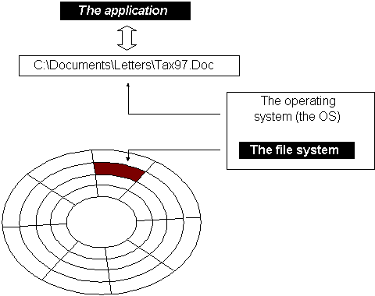
File System Forensic Analysis
New Technology File System (NTFS)
Notes:
In this lecture, we will continue studying file system forensic analysis techniques. Today, we will study how to examine another Windows-related File System, NTFS file system.

Slide 2
New Technology File System (NTFS)
Everything is a File
[1] NTFS - New Technology File System. http://www.ntfs.com/
Notes:
NTFS stands for New Technology File System. Everything is about a File in NTFS. Later, you will know that in order to understand how NTFS file system works, you only need to master or learn one file, Master File Table (MFT).

Slide 3

What does NTFS offer?
NTFS offers what FAT does not:
Reliability
Security
Scalability/Performance
… Mysterious: NTFS is a complex file system and, unfortunately, there is no published specification from Microsoft that describes the on-disk layout.
Data reverse engineering
It was designed to quickly perform standard file operations as:
Reading/Writing
Searching
...and File system recovery on very large hard disks
[1] NTFS - New Technology File System. http://www.ntfs.com/
Notes:
We already have so many file systems. From Windows perspective, we have FAT file system. However, NTFS offers what FAT does not:
NTFS is more reliable, secure and scalable with good performance of file access.
Unfortunately, NTFS is a very complex file system and, make matters worse, there is no published specification from Microsoft that describes the on-disk layout.

Slide 4


The FAT file system has become obsolete.
Notes:
Now, NTFS is widely used in Windows systems. some people is under the misimpression that the FAT file system has become obsolete.

Slide 5
FAT vs. NTFS
Dose of Reality:
FAT will still exist in mobile and small storage devices, but NTFS more likely for Windows
NTFS is more complex and more scalable
FAT retrieves a file by searching the chain of allocation units/directory entries, NTFS finds files more directly
Notes:
but FAT file system is actually widely used in mobile and small storage devices, but NTFS more likely for Windows systems today.
From a forensic point of view, it could be more challenging to analyze NTFS file system since NTFS is more complex and more scalable.
Of course, comparing to NTFS file system, FAT is slow since it retrieves a file by searching the chain of allocation units/directory entries, NTFS finds files more directly.

Slide 6



NTFS and Operating Systems
Designed by Microsoft and is the default file system for:
Windows NT
Windows 2000
Windows XP/Vista/7
......
Also used for most of the free Unix distributions, such as Fedora
Notes:
NTFS is designed by Microsoft and is the default file system for Windows OS. It is also used for most of the free Unix distributions, such as Fedora.

Slide 7

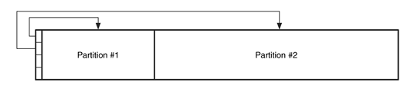
NTFS
NTFS volume
Formatted with the NTFS file system
Notes:
We are now looking at a scenario: we take a look at a partition, which is formatted with a NTFS file system.
[click]
A partition formatted with a NTFS file system is also called NTFS volume. We want to analyze it.

Slide 8
NTFS Volumes
The first information on the volume is the Partition Boot Sector which starts at Sector 0 and can be up to 16 sectors long
File System data
The first file on an NTFS volume is a Master File Table (MFT)
The MFT holds information about all files and folders on the volume
Everything is a File
Notes:
The first information on the NTFS volume is the Partition Boot Sector which starts at Sector 0 and can be up to 16 sectors long
It is File System data. It is named Partition Boot Sector, but in NTFS file system, it may contain more than one sector.
The first file on an NTFS volume is a Master File Table (MFT), and the MFT holds information about all files and folders on the volume.
So you know it is critical to find the MFT when examining an NTFS file system. This is why people always say that Everything is a File in NTFS.
Basically, it is about Master File Table (MFT).

Slide 9
The layout of NTFS Volume
Partition
Boot Sector
Master File Table
File Area
Data Area
Boot Sector: gives the starting location of the MFT (Master File Table), cluster size (1 to 128 sectors, but commonly 8), size of each MFT entry (usually 1024 bytes)
Master File Table: is basically a relational database table in which information (attributes) for each file or directory is represented by a record (entry) in the MFT
Notes:
The layout of an NTFS volume is very simple, and consists of two sections:
1. Partition Boot Sector (or Volume Boot Sector): It contains key information about NTFS file system structures; and
2. Data Area: It contains Master File Table (MFT), the most important file in NTFS, and the files’ data. Each record (entry) in the MFT represents a file or directory.
The Partition Boot Sector gives the starting location of the MFT (Master File Table), cluster size (1 to 128 sectors, but commonly 8), size of each MFT entry (usually 1024 bytes).

Slide 10
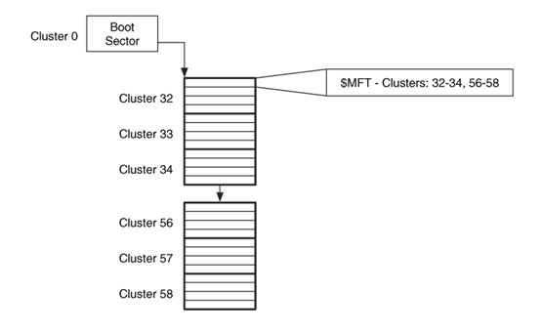
The relationship between the boot sector and $MFT with respect to determining the layout of the MFT
tell us the starting
location of the MFT
Contain many
MFT entries
tell us the location
of the MFT
Notes:
We know the Partition Boot Sector tells us the starting location of the MFT (Master File Table).
Also, we know the size of each MFT entry, 1024 bytes.
According to what we have known so far, "we can't, in the common sense, locate the MFT.
Therefore, in NTFS, the first MFT (MFT entry 0 or $MFT) describes the MFT itself, which determines its size and location, whereas the second MFT (MFT entry 1 or $MFTMirr) is the backup copy of the first entry in MFT.
In other words, locating the MFT would go through several stages. First, take a look at partition boot sector and find out the starting cluster address of the MFT. Second, locate the first cluster occupied by the MFT and look at its first 1024 bytes, which is MFT entry 0 ($MFT), which stands for the MFT file itself.

Slide 11

MFT entry (or MFT Records or file records)
Entry 0
Entry 1
Entry 2
Entry 3
……
Entry 4
MFT
……
Notes:
Next, we will take a look at how a MFT entry is organized. Note that each MFT entry represents a file or directory. It is also known as a file record.

Slide 12
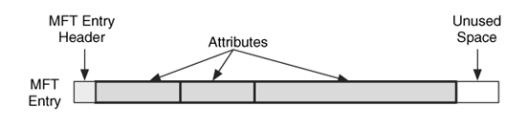
MFT entry (or MFT Records or file records)
1 KB
An MFT entry has a small header, and the rest of it is used to store different types of attributes. This entry has three attributes.
Notes:
An MFT entry has a small header, and the rest of it is used to store different types of attributes. There could be some unused space in the end of it.
The example MFT entry here has three attributes.

Slide 13
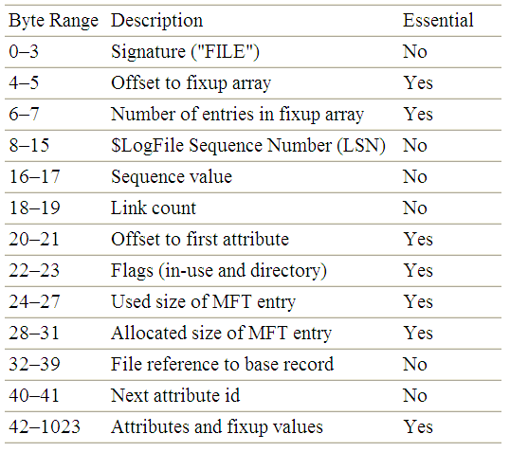
Data Structure for MFT Entries
"BAAD" if chkdsk found an error in it
Notes:
This is Data Structure for a MFT Entry. A MFT entry always start with “FILE”. A bad entry would start with “BAAD”.
[click]
If you look at the field at byte offset 20, you know where the first MFT attribute begins. After first attribute follows the second attribute and so forth, until the end of the entry.

Slide 14


File System Metadata Files
In NTFS, a file system metadata file is a critical MFT entry (record) or computer file without which a NTFS may not operate correctly.
System Files
Notes:
In NTFS, there are some File System Metadata Files (also known as System Files), which are used by NTFS file system to store metadata and implement the file system.
In NTFS, a file system metadata file is a critical MFT entry (record) or a computer file without which a NTFS may not operate correctly.

Slide 15

File System Metadata Files
The first 16 MFT entries (or MFT records) hold special information (names begin with $), reserved for file system metadata files storing store the file system's administrative data.
System Files
Entry | File Name | Description
0 | $MFT | The entry for the MFT itself
1 | $MFTMirr | Contains a backup of the first entries in the MFT.
2 | $LogFile | Contains the journal that records the metadata transactions
3 | $Volume | Contains the volume information such as the label, identifier, and version.
5 | . | Contains the root directory of the file system
Notes:
The first 16 MFT entries (or MFT records) hold special information (names begin with $), reserved for file system metadata files storing store the file system's administrative data.
For example, the first MFT (MFT entry 0 or $MFT) represents the MFT itself.
Also, we know that today's modern File Systems (including NTFS) organize folders and files in the hierarchical structure. So you can take a look at MFT entry 5 to find out the root directory of a NTFS volume.

Slide 16
File System Metadata Files (cont’d)
System Files
Entry | File Name | Description
6 | $Bitmap | Contains the allocation status of each cluster in the file system.
7 | $Boot | Contains the boot sector and boot code for the file system.
8 | $BadClus | Contains the clusters that have bad sectors.
9 | $Secure | Contains information about the security and access control for the files (Windows 2000 and XP version only).
Then, there follows one entry in the MFT for each file and for each directory
Notes:
Also, the MFT entry 6 (or $Bitmap) represents another important system information in a file system, the allocation status of each data unit in the NTFS file system.
After these 16 system files, there follows one entry in the MFT for each file and for each directory

Slide 17

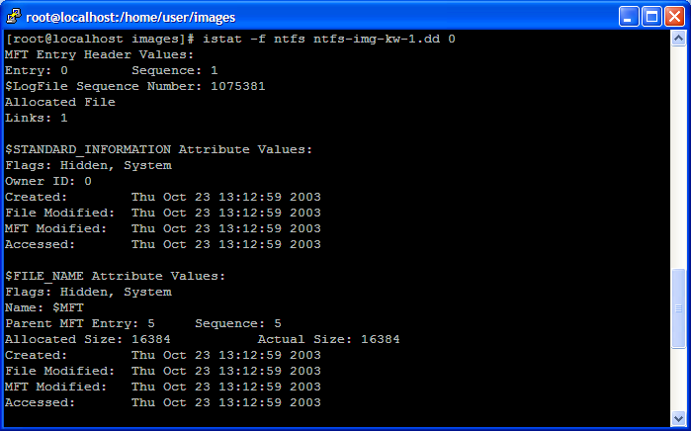
First MFT entry
Timestamps
Timestamps
Notes:
This is an example output of the TSK istat tool for MFT entry 0.
You can see the name of the file represented by MFT entry 0 is $MFT.

Slide 18
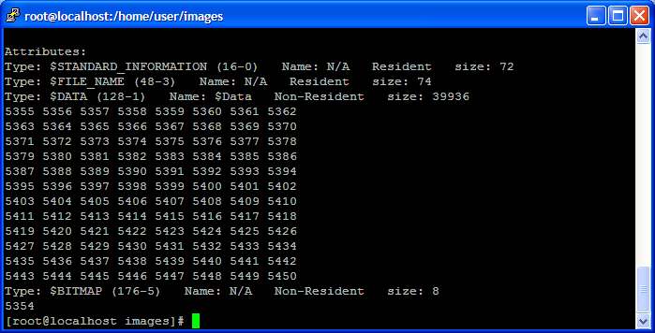
Where MFT is located!
Notes:
Also, the TSK istat tool shows the locations of the MFT.

Slide 19

MFT Entry Attribute
Notes:
Next, we will take a look at how a MFT Entry Attribute is organized.
Note that a MFT entry has a header and a set of attributes that describe the file or directory.

Slide 20
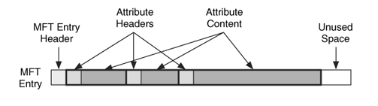
MFT Entry Attribute Concepts
1 KB
An MFT entry has a small header, and the rest of it is used to store different types of attributes. This entry has three attributes.
Notes:
An MFT entry has a small header, and the rest of it is used to store different types of attributes. There could be some unused space in the end of it. The example MFT entry here has three attributes.
Each MFT entry attribute can be divided into two parts: Attribute head and attribute content.

Slide 21

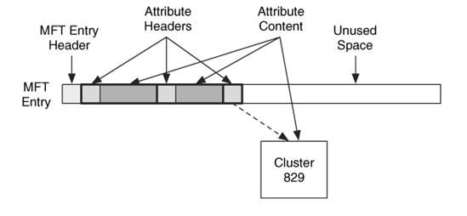
Attribute Content
Non-resident attribute
Resident attribute
Attribute values are either resident
or non-resident
Notes:
Where is attribute content located?
Two possibilities: stored inside MFT entry and stored in the file area.
An attribute whose content is stored inside MFT entry is called Resident attribute.
An attribute whose content is stored in the file area is called Non-resident attribute. In the example here, the content of the Non-resident attribute can be found in Cluster 829.

Slide 22
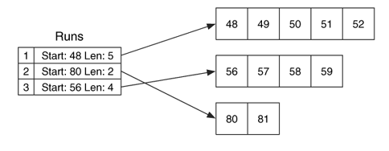

Attribute Content (cont’d)
Non-resident values are stored in cluster runs (data runs).
Logical file system address
cluster number
What is the logical
file address?
contiguous
virtual cluster number
Example runlist with three runs of allocated clusters
Notes:
For Resident attributes, you can simply look through the MFT entry to find the attribute content since it is stored inside MFT entry.
But, it needs more work to locate the attribute content of Non-Resident attributes.
Non-resident values are stored in cluster runs, aka data runs. Each cluster run is defined by its starting cluster and its length in clusters. In the example here, cluster run #1 occupies Clusters 48 to 52. Total are 5 Clusters or data units.
[click]
Looks familiar to you?
[click]
We are talking about contiguous allocation.
[click]
48 is logical file system address or cluster number.
[click]
What is the logical file address for Cluster 48? logical file address is called virtual cluster number in NTFS.
Recall that each cluster allocated to a file is also assigned with a file address, which is relative to the beginning of the file. The first data unit would have a logical file address of 0, and the second would have a logical file address of 1.
Since Cluster 48 is the first cluster allocated the file, therefore the logical file address for Cluster 48 is 0.

Slide 23

What does an MFT Entry Attribute look like?
Notes:
What does an MFT Entry Attribue look like? Or, how is an MFT Entry Attribute organized?

Slide 24
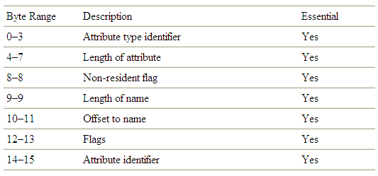
Data Structure for Attribute
Data structure for the first 16 bytes of an attribute
Notes:
This is Data Structure for MFT Attribute, particularly, the first 16 bytes of an MFT attribute.
The first field is Attribute type identifier, which is used to define the Attribute type.
For example, Later you will know that 48 stands for the $FILE_NAME attribute, which defines the file name.

Slide 25
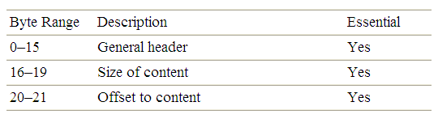
Data Structure for Attribute (cont’d)
Data structure for a resident attribute
Notes:
As we already know, there are two types of MFT attributes: Resident attribute and Non-resident attribute according to the locations of their attribute contents.
In addition to the general header for an MFT attribute, data structure for a resident attribute is very simple.
Basically, we need to know where the attribute content starts (looking at the field at byte offset 20) and its size (looking at the field at byte offset 16). Then, we are good to go.

Slide 26

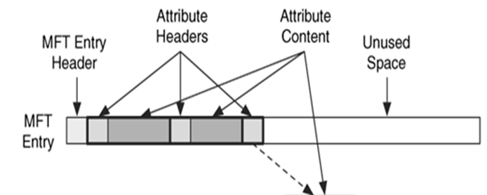
Data Structure for Attribute (cont’d)
Non-resident attribute
Notes:
However, for a Non-resident attribute, the situation will be very different. Remember that Non-resident values are stored in cluster runs, aka data runs. Each cluster run is defined by its starting cluster and its length in clusters. So we will need to figure out cluster runs.

Slide 27
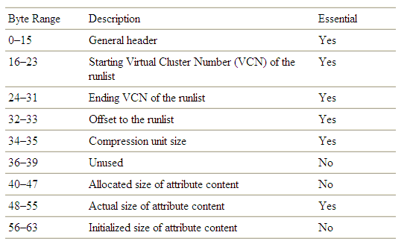
Data Structure for Attribute (cont’d)
Location of attribute content.
Data structure for a non-resident attribute
Notes:
Next, let us take a look at Data structure for a non-resident attribute in more detail.
[click]
We look at three important fields, which list all the clusters allocated to the file and represented in cluster runs.
[click]
If you only know all the clusters allocated to an MFT entry attribute, it is not enough to locate the attribute content. You also need to know the attribute content size. Remember that there could be some used space in the disk space occupied by an MFT entry attribute, particularly, in the last data unit or cluster allocated to the attribute. It is very similar to slack space in a file.

Slide 28
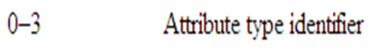
What types of Attribute are there (are possible)?
Attribute
Notes:
As mentioned, the first field in an MFT entry attribute is Attribute type identifier, which is used to define the Attribute type.
So what types of Attribute are there?

Slide 29

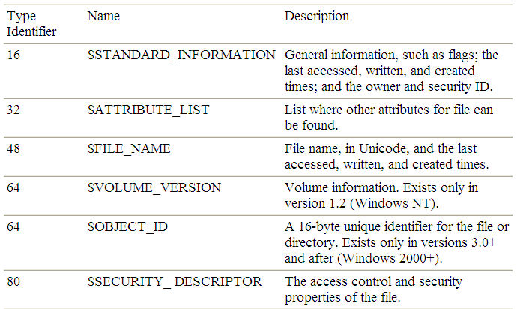
Standard Attribute Types
The attributes can be classified into many types according to types of information stored into it.
Notes:
NTFS defines many attribute types. Some common ones are, for example,
48 stands for the $FILE_NAME attribute, which defines the file name. In addition, it also includes some important timestamps, or MAC times. Please note that different from FAT file system, the file name in NTFS is in Unicode.

Slide 30
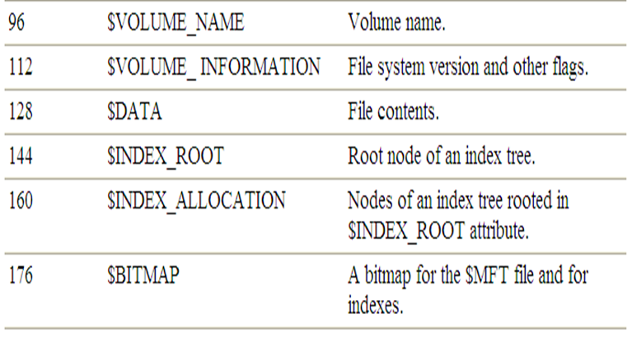
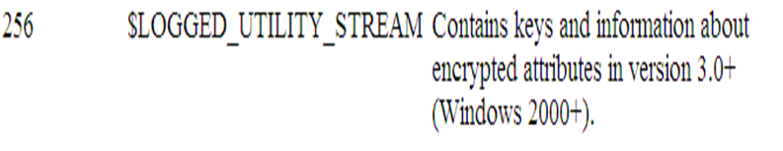
Standard Attribute Types (cont’d)
Notes:
Another important attribute type is 128, which stands for data attribute. It contains the actual file content.
Also, you may already know that NTFS file system supports file encryption. So I would like to direct you to pay attention to another important attribute type, $LOGGED_UTILITY_STREAM, which is in use by the encrypting file system. It will be detailed later.

Slide 31

$FILE_NAME attribute
How does an Attribute look like?
Notes:
Next, we will use a real example to take a look at How an MFT entry Attribute looks like. We will use $FILE_NAME attribute as an example here.

Slide 32
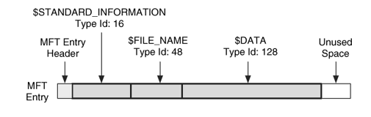
An example MFT entry where the type names and identifiers have been added to the attributes.
Notes:
As mentioned, An MFT entry has a small header, and a set of attributes. Also, there could be some unused space in the end of it.
The example MFT entry here has three attributes, including $STANDARD_INFORMATION, $FILE_NAME, and $DATA.
Now our goal is to locate the $FILE_NAME attribute and analyze it. In other words, we want to analyze a $FILE_NAME attribute and figure out the file name.
Please note that it is very usual that the $FILE_NAME attribute is not the first attribute.

Slide 33

Data Structure for MFT Entries
Notes:
Recap the Data Structure for MFT Entries. Particularly, we look at the field at byte offset 20 (0x14 in hex), which indicates the beginning of the first attribute.

Slide 34

But we are looking for …
Notes:
It is very usual that the $FILE_NAME attribute is not the first attribute. In other words, we are not looking for the first attribute.

Slide 35
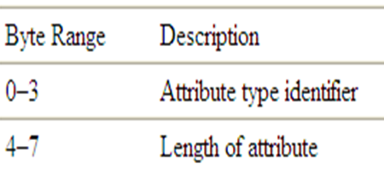
Data Structure for an Attribute
Type: 48 = $FILE_NAME attribute
Then, we know the start point of the next attribute.
Notes:
Recap the Data Structure for MFT Entry Attribute. Particularly, we look at the field at byte offset 4, which indicates the length of the attribute.
[click]
Technically speaking, we know the start point of the next attribute.
As such, starting from the first attribute, we can go over the attributes one by one, looking for one attribute whose Attribute type identifier is 48. It means $FILE_NAME attribute.

Slide 36
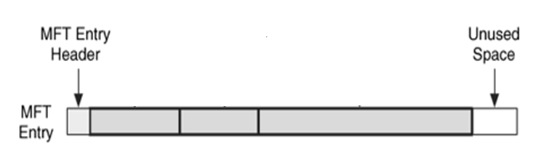
Data Structure for an Attribute (cont’d)
Length of attribute
Notes:
Specifically, we first figure out the starting point of the first attribute by inspecting the field at byte offset 20 (0x14 in hex) in the MFT Entry. Afterwards, we inspect the field at byte offset 4 in the first attribute and know its length.
As such, we also figure out the starting point of the next attribute, which is the second attribute. As we continue to look over each attribute, we should be able to locate one attribute whose Attribute type identifier is 48. It means $FILE_NAME attribute.

Slide 37

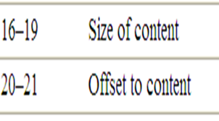

Data Structure for an Resident Attribute
Type: 48 = $FILE_NAME attribute
Notes:
After we find out the $FILE_NAME attribute, we can extract its content, which is $FILE_NAME structure.

Slide 38
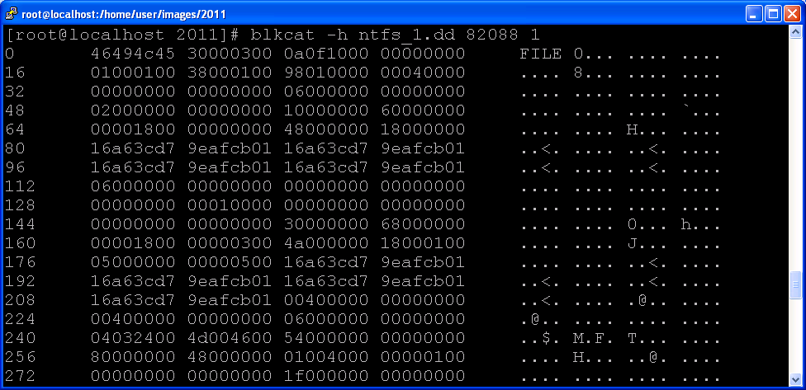
Signature (“file”)
MFT entry 0
Offset to first attribute = 56
first attribute = Type: 16, length: 96
second attribute = Type: 48, length: 104
size of Attribute content = 104
offset to content = 24
File Name Attribute content
Notes:
This is a hex dump of the MFT entry (or MFT entry 0).
A MFT entry start with “FILE”. We take a look at the field at byte offset 20, knowing the offset to the first attribute or the starting point of the first attribute. The value in the field at byte offset 20 is 0038 in hex, which is converted to 56 in decimal.
So we know the first attribute starts at byte offset 56. However, we look at the first 4 bytes of the first attribute, which is Attribute type identifier. The value is 16, which is not the $FILE_NAME attribute. Next, we inspect the field at byte offset 4 in the first attribute and know its length.
So we move on to the next or second attribute. In other words, we know that the second attribute starts at byte offset 152, which is 56 plus 96.
We look at the first 4 bytes of the second attribute, which is Attribute type identifier. The value is 48, which is the $FILE_NAME attribute. We find it.
Afterwards, we figure out the starting point of the attribute content in the $FILE_NAME attribute as well as its size of the attribute content.
The File Name Attribute content is included within the blue square.

Slide 39
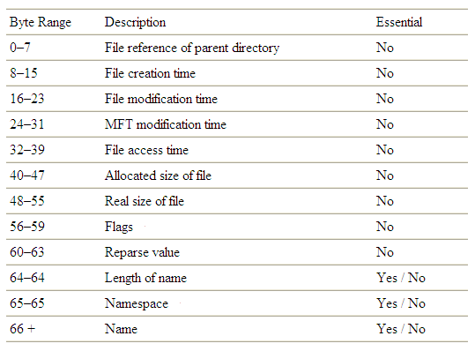
Data structure for the $FILE_NAME structure
Notes:
Next, we will need to parse the File Name Attribute content.
This is Data structure for the $FILE_NAME structure, which is contained in the $FILE_NAME attribute.
Particularly, we are interested in two fields:
The field at byte offset 64 indicates the length of the file name
The field starting at byte offset 66 contains the file name.

Slide 40
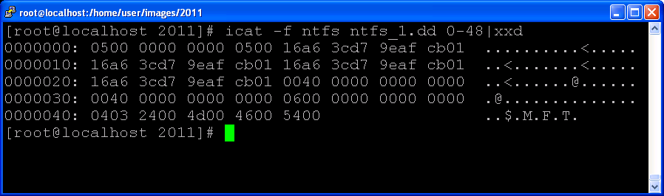
MFT entry 0
$FILE_NAME
$FILE_NAME
structure
$FILE_NAME
Byte Range | Description
64-64 | Length of name
66+ | Name
Offset: 64
Offset: 66+
Length of
file name
file name
Notes:
Next, we will use the example again to take a look at how to parse out the file name. First, we will need to extract the content of the $FILE_NAME attribute.
You can also simply use the TSK tool icat to dislay the content of the $FILE_NAME attribute for a MFT entry (MFT entry 0 in the example here), and then use the Linux utility xxd to show its hex dump.
[click]
We inspect the field at byte offset 64, which is the length of the file name.
The value is 4, which means the file name length is 4.
[click]
We then inspect the field starting at byte offset 66, which contains the file name. Note that the file name uses Unicode, which means each character uses two bytes here. We know the file name is $MFT.

Slide 41

Encryption
Notes:
NTFS provides many special features to improve storage performance and data storage efficiency as well as data security. As such, more advanced attribute types are defined. Next, we will take a look at file encryption in NTFS.

Slide 42

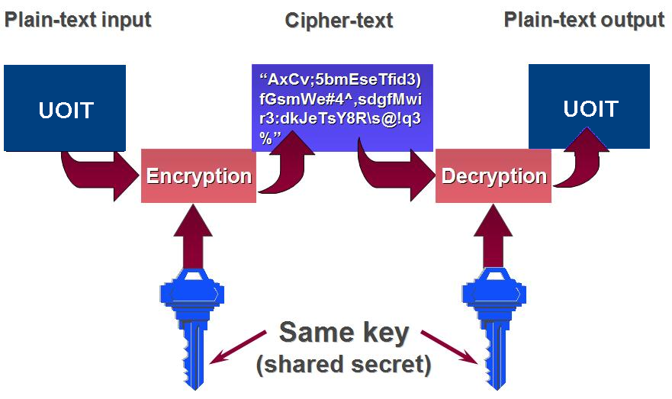


Symmetric Encryption
Data Secrecy
Encrypted Attributes
Encryption and decryption use the same key.
Alice
Bob
Notes:
There are two types of encryption, Symmetric encryption and Public-Key Encryption.
Symmetric encryption uses the same symmetric key to encrypt data and decrypt the encrypted data back to its original form.
The secret key, is sometimes referred as "encryption key" or "shared key", because both sending and receiving parties should know it in advance.

Slide 43
Public-key (or Asymmetric) Encryption
Encrypted Attributes (cont’d)
Each person has two keys
Public key and Private key
+
Bob’s public
key
K
B
-
Bob’s private
key
K
B
plaintext
message, m
encryption
algorithm
ciphertext
decryption
algorithm
plaintext
message
+
K (m)
-
+
B
m = K (K (m))
B
B
Notes:
In Public-key encryption, each user has two keys, one is public key known to the public and another is private key only known to the owner itself.
In Public-Key Encryption, anyone can encrypt messages using other’s public key, but only the holder of the paired private key can decrypt it.
For example, Alice wants to send a secret message “Hello Bob!” to Bob. So Alice uses Bob’s public key to encrypt the message. Afterwards, Alice forwards the ciphertext to Bob.
Bob can use his private key to decrypt it and get the plaintext “Hello Bob!”.

Slide 44


Encrypted Attributes (cont’d)
However, asymmetric key algorithms are very slow:
In practice, asymmetric key algorithms are typically hundreds to thousands times slower than symmetric key algorithms.
Q: What if we need to encrypt a large document?
Symmetric-key algorithms are generally fast, but Key management is a problem.
Notes:
However, asymmetric key algorithms are very slow:
In practice, asymmetric key algorithms are typically hundreds to thousands times slower than symmetric key algorithms.
What if we need to encrypt a large document?
Symmetric-key algorithms are generally fast, but key management is a problem.

Slide 45


Hybrid Encryption
Encrypted Attributes (cont’d)
Instead of:
Message
Message
Encrypted with Alice’s Public Key
Use:
Randomly
Chosen K
Message
+
Encrypted with
Alice’s Public Key
Encrypted with
Secret Key K
Asymmetric Encryption
Symmetric Encryption
Notes:
So we talk about a combination of Symmetric-key encryption and asymmetric key encryption. It is also hybrid encryption.
As such, hybrid encryption allows users to encrypt data with the speed of Symmetric-key encryption and the convenience and security of public key encryption.
Specifically, suppose a user wants to send a secret message to someone else. So the sender first randomly picks up a secret key (or a symmetric key) and then uses the receiver’s public key to encrypt the randomly chosen key k. Afterwards, the sender uses the randomly chosen secret key to encrypt the message. Afterwards, the sender put together the encrypted secret key as well as the encrypted message and forward it in a whole to the receiver.
Upon receipt of the encrypted message, the receiver can use his or her private key to decrypt the protected symmetric key and get the secret key randomly chosen by the sender. Then, the receiver can use the obtained symmetric key to decrypt the protected message.
It is also known as Digital Envelopes.
[click]
It uses Asymmetric Encryption
[click]
It uses Symmetric Encryption

Slide 46

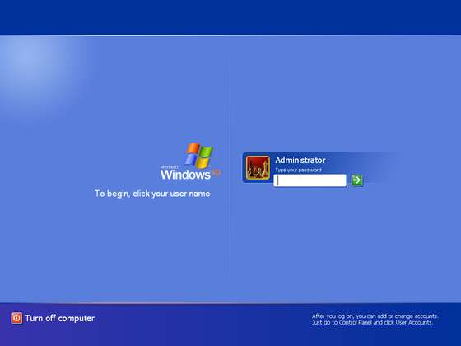

Encrypted Attributes (cont’d)
1024-bit RSA algorithm
Public Key
Private Key
protected by the user's logon password
Notes:
The hybrid encryption technique is also adopted for file encryption. For example, the NTFS Encrypting File System (EFS) uses hybrid encryption:
Each use has a pair of keys, one is public key known to the public and another is private key only known to the owner itself. The private key is protected by the user's logon password.

Slide 47






Encrypted Attributes (cont’d)
$LOGGED_UTILITY_STREAM Attribute
File Content
User 1’s Public Key
User 1’s Encrypted FEK
Encrypt
Encrypt
(DESX)
Random Key
(FEK)
File Encryption Key
Encrypt
$DATA
Attribute
User 2’s Encrypted FEK
User 2’s Public Key
Encrypted File Context
Encryption process starting with file content and public keys and ending with encrypted content and encrypted keys
Notes:
First, the file content is encrypted with a random symmetric key, (called File Encryption Key (FEK)). Then this File Encryption Key is encrypted with the public keys of each of the users allowed to decrypt the file.
Afterwards, the encrypted file encryption key will be put into $LOGGED_UTILITY_STREAM attribute, and the encrypted file content is saved into the $DATA attribute.

Slide 48
Encrypted Attributes (cont’d)
$DATA
Attribute
Encrypted File Content
$LOGGED_UTILITY_STREAM Attribute
User 1’s Encrypted FEK
Random Key
(FEK)
Encrypt
(DESX)
Decrypt
User 1’s Password
Decrypt
User 1’s
Private Key
Registry Value
File Content
User 1’s Encrypted Private Key
Decryption process starting with encrypted content, keys, and a user password, and ending with the decrypted content
Notes:
Decryption process starts with decrypting encrypted File Encryption Key (FEK).
Specifically, after the user logs into his or her account, the user will access his or her private key. Then, the user can use his or her private key to decrypt the protected File Encryption Key (FEK). Then, the user can use the obtained File Encryption Key (FEK) to decrypt the protected file content.

Slide 49

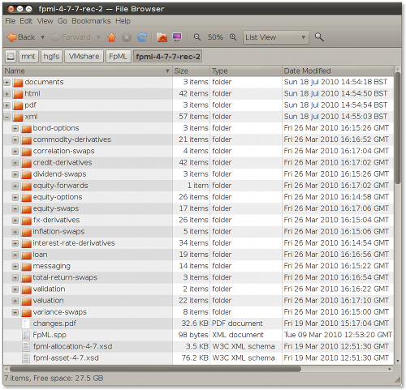

Efficient file lookup technique
To sort the file names into an index,
for example, based on the hash value.
Notes:
We do file lookup very often. But you don’t want to wait too long.
Unfortunately, we may have thousands of files on our hard disk.
[click]
Therefore, we need fast file lookup technique.
[click]
The popular way is to sort the file names into an index, for example, based on the hash value.

Slide 50
Index
NTFS uses index data structures in many situations. An index in NTFS is a collection of attributes that is stored in a sorted order, which can be used for fast lookup.
The most common usage of an index is in a directory because directories contain $FILE_NAME attributes.
An NTFS index sorts $FILE_NAME attributes (particularly file names) into a tree, specifically a B-tree.
A tree is a group of data structures called nodes that are linked together such that there is a head node and it branches out to the other nodes.
Notes:
NTFS also uses indexing.
NTFS uses index data structures in many situations. An index in NTFS is a collection of attributes that is stored in a sorted order, which can be used for fast lookup.
The most common usage of an index is in a directory because directories contain $FILE_NAME attributes.
An NTFS index sorts $FILE_NAME attributes (particularly file names) into a tree, specifically a B-tree

Slide 51
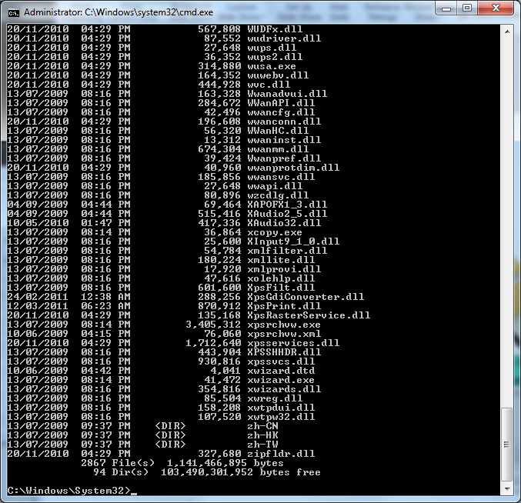

The file names have been indexed
fast
Notes:
Since the file names have been indexed, we can quickly find a file based on its name.

Slide 52
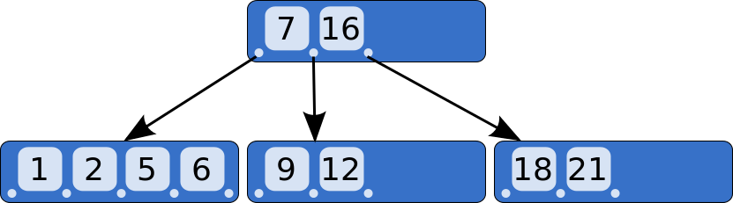
NTFS uses Tree-based Indexing, specifically, B-Tree, A Balanced Tree Data Structure
[1] Knuth, Donald (1998), Sorting and Searching, The Art of Computer Programming, Volume 3 (Second ed.), Addison-Wesley, ISBN 0-201-89685-0.
Notes:
NTFS uses Tree-based Indexing, specifically, B-Tree, which is A Balanced Tree Data Structure.

Slide 53
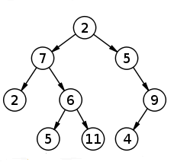
Some Terminologies on Tree
Node
A node is a structure which may contain value(s) (key(s))
Root
The topmost node in a tree
Child and parent
Every node except the root has one parent
A node can have an arbitrary number of children
Leaves
Nodes with no children
Sibling
nodes with same parent
Notes:
Next, let’s quickly review some basic concepts of Tree.
A tree data structure can be defined recursively as a collection of nodes (starting at a root node), where each node is a data structure consisting of a value, together with a list of references to nodes (the "children"), with the constraints that no reference is duplicated, and none points to the root.
In other words, no circle.

Slide 54
Some Terminologies on Tree (cont’d)
Depth of a node
length of the unique path from the root to that node
The depth of a tree is equal to the depth of the deepest leaf
Height of a node
The length of the longest downward path to a leaf from that node.
All leaves are at height 0. The height of a tree is equal to the height of the root
Depth 3, Height 0
Notes:
The Depth of a node refers to the length of the unique path from the root to that node
The Height of a node refers to the length of the longest downward path to a leaf from that node.
For the example Node 5, its depth is 3, and its height is 0.

Slide 55


7
binary tree
5
9
4
8
18
6
Binary Search Tree
How many child(ren) does node 9 have? What is child(ren) of node 9?
Which nodes are leaf nodes (leaves)?
What is the height of node 8?
What is the depth of nodes 4, 6, 8, and 18?
2 children, Nodes 8 and 18
Nodes 4, 6, 8 and 18
0
All have the depth of 2
Notes:
Next, let’s do an in-class test together. I will use a simple binary tree as an example.
[click]
2 children, Nodes 8 and 18
[click]
Nodes 4, 6, 8 and 18
[click]
0
[click]
All have the depth of 2

Slide 56

B-tree
A Node with
2 keys or 3 Children
A B-tree is a tree data structure that keeps data sorted and allows searches, insertions, deletions, and sequential access in a very efficient way.
7
16
The B-tree is a generalization of a binary search tree in that more than two paths diverge from a single node.
The B-tree is optimized for systems that read and write large blocks of data. It is most commonly used in databases and file systems.
1
2
18
21
9
12
[1] B-tree. http://en.wikipedia.org/wiki/B-tree
Notes:
Now, we will take a look at the B-tree structure, which is used in NTFS for indexing.
A B-tree is a tree data structure that keeps data sorted and allows searches, insertions, deletions, and sequential access in a very efficient way.
The B-tree is optimized for systems that read and write large blocks of data. It is most commonly used in databases and file systems.
[click]
An example node of B-tree contains 2 keys, which can have three children. This the maximum number of children for a node with 2 keys.

Slide 57
B-tree (cont’d)
A B-tree of order n (the maximum number of children for each node) consists of
a root which has at least 2 children (if not a leaf), and all other nodes (except the root) have at least children ceil(n/2) (ceil(n/2)- 1 keys) . Every node has at most n children (n-1 keys (or data values)) .
ceil(n/2)<=k<=n
Where k represents the number of children
A B-tree is kept balanced by requiring that all leaf nodes are at the same depth.
Ordering: The keys (values) in the data items in all nodes are in increasing order.
1
2
3
Notes:
Of course a B-tree must be a tree data structure.
Also, a B-tree of order n (the maximum number of children for each node) must satisfy the following important properties:

Slide 58
This means that (other that the root node) all internal nodes have at least ceil(5 / 2) = ceil(2.5) = 3 children (and hence at least 2 keys). Of course, the maximum number of children that a node can have is 5 (so that 4 is the maximum number of keys).
10
3
6
13
16
1
2
4
5
7
8
9
11
12
14
15
17
18
19
20
A B-tree of order 5
Notes:
Next, let’s take a look at an example B-tree of order 5.
[click]
This means that (other that the root node) all internal nodes have at least ceil(5 / 2) = ceil(2.5) = 3 children (and hence at least 2 keys). So it is satisfied for the example.
Of course, the maximum number of children that a node can have is 5 (so that 4 is the maximum number of keys). It is also satisfied for the example.
Finally, all leaf nodes are at the same depth, 2. The key values in the data items in all nodes are in increasing order.
We know the example tree here is a B-tree.

Slide 59
A B-Tree is a height balanced search tree
An index speeds the search
B-tree
A
eee.txt
lll.txt
ttt.txt
E
B
vvv.txt
zzz.txt
aaa.txt
bbb.txt
D
A
B-tree of order 4
ooo.txt
rrr.txt
C
fff.txt
ggg.txt
iii.txt
3 key values and 4 children
A B-tree with file names as values
Notes:
Now we take a look at example of B-tree with file names as keys (values).
This is an example of a B-tree of order 4. It means that the maximum number of children for each node is 4. In other words, the maximum number of keys (values) which can be contained in a node is 3.
[click]
An index speeds the search. For example, if we search for bbb.txt, only three comparisons need to be done for the search.
First, we search at the root node A, since bbb.txt is less than eee.txt, we know that if the target file name occurs anywhere in the list, it must be before Node A since the list of file names was presorted in B-tree. In other words, it is Node B.
We then go to Node B, and obviously, after comparisons, we find the target file, bbb.txt.
However, you know from your computer algorithm course that to find a particular item in an unsorted list, we are forced to use sequential search, and the number of comparisons are needed using sequential search in the worst case is the total number of items in the list, which is 12 in the example. Also, it can be observed that when a group of file names is sorted, for example, using B-tree, as the number of file names increase, the file searching will be increased dramatically.

Slide 60
File creation
B-tree (cont’d)
A
eee.txt
lll.txt
ttt.txt
E
B
vvv.txt
zzz.txt
aaa.txt
bbb.txt
D
ooo.txt
rrr.txt
C
fff.txt
ggg.txt
iii.txt
jjj.txt
each node can have only three names (or values)
Add file jjj.txt into the B-tree
Notes:
Next, suppose we create a file, which is jjj.txt. Now we need to insert the name jjj.txt of the newly created file into the index.
Since jjj.txt is larger than the file name iii.txt and less than than the file name lll.txt, the possible insertion point is here, after iii.txt in Node C.
However, we now have a problem: when that happens, we inserts the file name jjj.txt at the current insertion point, the Tree violates one property of B-tree, each node can have only three names (or values) for our example. Note that Node C has 4 keys now.
Please note that we deal with a B-tree of order 4.

Slide 61
each node can have only three names
B-tree (cont’d)
A
eee.txt
ggg.txt
lll.txt
ttt.txt
B
E
aaa.txt
bbb.txt
D
vvv.txt
zzz.txt
ooo.txt
rrr.txt
F
G
fff.txt
iii.txt
jjj.txt
Add file jjj.txt into the B-tree
Notes:
As such, the current tree must be resorted in order to make it B-tree. For example, we split Node C. However, it still doesn’t work since Node A has 4 keys now.
But, the Tree is still not a B-tree. Note that Node A has 4 keys now, but each node can have only three names (or values) for our example.

Slide 62
B-tree (cont’d)
H
ggg.txt
I
J
eee.txt
lll.txt
ttt.txt
B
E
aaa.txt
bbb.txt
D
vvv.txt
zzz.txt
ooo.txt
rrr.txt
F
G
fff.txt
iii.txt
jjj.txt
Add file jjj.txt into the B-tree
Notes:
As such, the current tree has to be resorted again in order to make it B-tree. For example, we split Node A.
Finally, we can see it becomes a B-tree again.

Slide 63
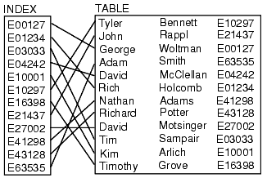
DATABASE INDEXES
USING DATABASE INDEXES to improve the performance of database activity, such as speeding up the query significantly
Notes:
This is very similar to Database indexes. We always use DATABASE INDEXES to improve the performance of database activity, such as speeding up the query significantly. Similarly, we index the file names to speed up file searching in a file system. However, you may also notice that Inserting data with indexes is slower while making finding data faster and easier.
This is because data has to be put in the correct place.

Slide 64
File deletion
B-tree (cont’d)
each node at lest has one name (ceil(4/2)-1=1)
H
ggg.txt
I
J
eee.txt
lll.txt
ttt.txt
B
E
aaa.txt
bbb.txt
D
vvv.txt
zzz.txt
ooo.txt
rrr.txt
F
F
G
fff.txt
iii.txt
jjj.txt
Delete file fff.txt from the B-tree
Notes:
How about file deletion? Suppose we now delete the file fff.txt. So its index entry will be removed and become unallocated. In other words, Node F becomes empty in the example.
[click]
Unfortunately, the Tree violates another property of B-tree, each node at lest has one name (ceil(4/2)-1=1) for our example.
Please note that we deal with a B-tree of order 4.

Slide 65

B-tree (cont’d)
Deleted file names are difficult to find in NTFS
H
ggg.txt
I
J
bbb.txt
lll.txt
ttt.txt
B
E
aaa.txt
D
vvv.txt
zzz.txt
ooo.txt
rrr.txt
F
F
G
fff.txt
eee.txt
iii.txt
jjj.txt
Delete file fff.txt from the B-tree
Notes:
Therefore, the current tree must be resorted in order to make it B-tree. For example, we move file name eee.txt to Node F.
[clcik]
As such, the file name fff.txt may be overwritten.
[click]
It poses a challenge to the deleted file recovery: Sometimes deleted file names are difficult to find in NTFS. This is different from FAT file system, where the most part of the file name of a deleted file still remains.
Please note that as a file is deleted, the deleted file’s contents still remain on you hard disk, which can be recovered if it is not overwritten yet.

Slide 66
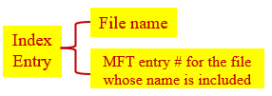
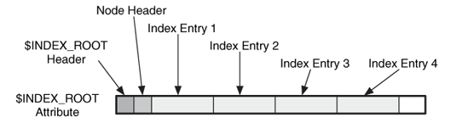
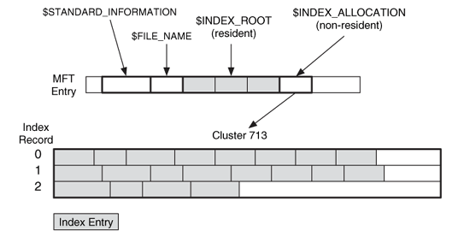
Index Attributes
A node in an NTFS directory index tree with four index entries
This directory has three index entries in its resident $INDEX_ROOT attribute and three index records in its non-resident $INDEX_ALLOCATION attribute.
Notes:
The most popular usage for the index in NTFS is to create a B-Tree to index the names of the files and or sub-directory in a directory, making finding a specific file or sub-directory faster. Therefore, the key values in an index node (B-Tree nodes) are the file names, more specifically $FILE_NAME structures.
NTFS stores this index in the Index_Root and Index_Allocation Attributes in the directory’s MFT entry, where the $INDEX_ROOT attribute is a resident attribute and the $INDEX_ALLOCATION attribute is a non-resident attribute.
The example at the top shows that a directory has four index entries in its resident $INDEX_ROOT attribute. Note that an index entry stores a $FILE_NAME structure and MFT entry # for the file whose name is included. As such, the directory only has 4 files or sub-folders.
However, sometimes a directory may contain many files. As such, we may have enough disk space in a MFT entry to store all index entries. Then, we need the Index_Allocation Attribute.
The second example shows that a directory has three index entries in its resident $INDEX_ROOT attribute and three index records in its non-resident $INDEX_ALLOCATION attribute.

Slide 67

NTFS Analysis
Notes:
Now we have learned some basics about NTFS file system. Next, we will discuss some popular analysis techniques for NTFS.

Slide 68
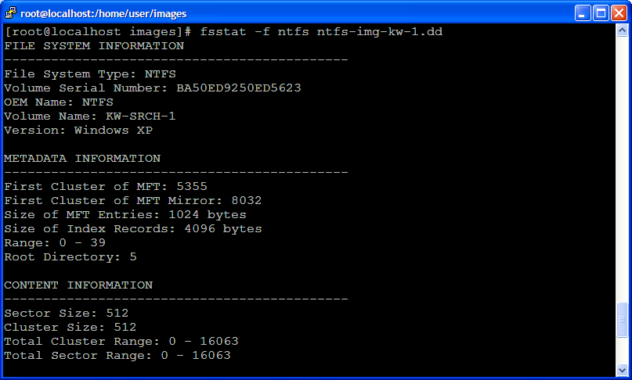
File System Category
Notes:
First, we look at how to analyze file system data. We now know we can use the TSK utility fsstat to display the details associated with a NTFS file system.
[click]
Everything is a File in NTFS, which is Master File Table (MFT). In the example here, you know the first cluster of MFT is 5355.

Slide 69

File System Category (cont’d)
File system layout
Windows creates MFT as small as possible and only expands it when there are more entries
To decrease the possibility of fragmentation, NTFS uses the MFT Zone (12.5% of the file system allocated to MFT)
Notes:
Regarding MFT, Windows has a secret. Windows creates MFT as small as possible and only expands it when there are more entries
To decrease the possibility of fragmentation, NTFS usually allocates 12.5% of the file system to MFT.

Slide 70
Content Category
An NTFS file is a collection of attributes, some resident, some nonresident
A cluster is a group of consecutive sectors and the number of sectors per cluster is a power of 2
Each cluster has an address, starting with 0
$BITMAP has a $DATA attribute that has one bit for every cluster in the file system
If the bit = 1 the cluster is allocated, if the bit=0 it is unallocated allocation status
To convert a cluster address to a sector address, multiply it by the number of sectors in a cluster
Clusters are allocated to files by a best fit algorithm.
Notes:
We next look at analysis techniques of file content data in NTFS.
The entire NTFS volume is divided into a number of data units or clusters.
Each cluster has an address, starting with 0. Note that this is different from FAT file system, starting with 2.
In NTFS, there is $BITMAP, which has a $DATA attribute that has one bit for every cluster in the file system, which indicates allocation status. If the bit = 1 the cluster is allocated, if the bit=0 it is unallocated. Also, Clusters are allocated to files by a best fit algorithm, which means contiguous allocation.
As we know, we can use different ways to locate a disk space, for example, using the logical partition volume address, which is a sector number, and file system address, cluster address or number.
To convert a cluster address to a sector address, it is very easy in NTFS, simply multiplying it by the number of sectors in a cluster.

Slide 71
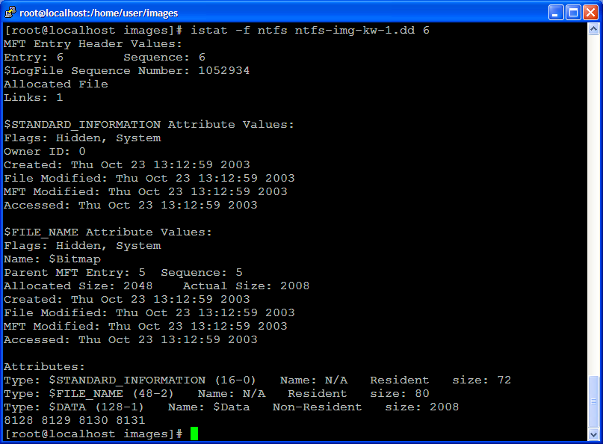
Content Category (cont’d)
Notes:
This is an example of $BITMAP, which is a File System Metadata File in NTFS, which is associated with MFT entry 6.

Slide 72
Content Category (cont’d)
Sector 0
Data Area
Partition
Boot Sector
Master File Table
File Area
cluster 0
cluster 1
Question: what is the cluster address of sector 100? Assume the cluster size is 4096 Bytes?
floor(100/8)
=floor(12.5)
=12
Notes:
Let’s take a look at an question: what is the cluster address of sector 100? Assume the cluster size is 4096 Bytes?
[click]
We divide 100 by 8, and apply floor function. We obtain Cluster 12.

Slide 73
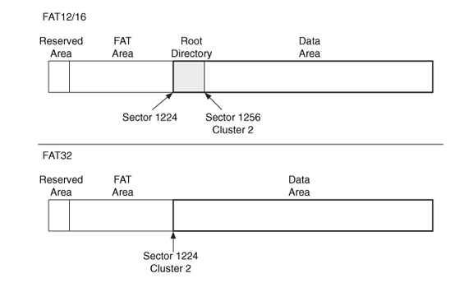

Content Category (cont’d)
But it is a totally different story in FAT file system …
No Cluster Number!
139
Notes:
As mentioned, the entire NTFS volume is divided into a number of data units or clusters, starting from the begin of the NTFS volume.
But it is a totally different story in FAT file system. There is no cluster number for these disk space before data area in FAT32 or before data area in FAT12/16 plus root directory.

Slide 74
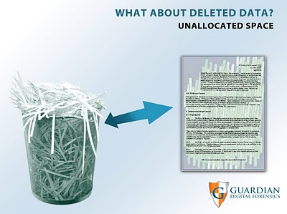
Content Category (cont’d)
Analysis Techniques
Finding a cluster: The first cluster is at the start of the file system, and the cluster size is given in the first sector
Allocation status of a cluster: Locate the $BITMAP file and process its $DATA attribute
Extracting unallocated space: Again, use the $BITMAP file
Notes:
So some analysis techniques of file content data in NTFS are:
Finding a cluster: Since the first cluster is at the start of the NTFS file system, and also the cluster size is given in the partition boot sector. So we can easily locate the cluster.
Also, we can locate the $BITMAP file and process its $DATA attribute, figuing out the allocation status for each cluster.
As a result, we are able to know which clcuster is unallocated. Then, we can extract these unallocated space. Again, we use the $BITMAP file.

Slide 75

Content Category (cont’d)
Analysis Scenario
Goal: Locate cluster 9,900,009
Step 1: Determine cluster size
A sector is 512 bytes and a cluster is 8 sectors ⇨ 4,096 bytes
Step 2: Determine sector address
Cluster 0 in NTFS starts with sector 0, thus the sector address of our cluster is 79,200,072
Step 3: Determine byte location
Multiply the sector address by 512 and get byte offset 40,550,436,864
9,900,009X8
79,200,072X512
Notes:
Next, let’s do a case study together. Our goal is to locate cluster 9,900,009 in a NTFS volume.
Of course, we assume the NTFS volume is big enough, having more than 9,900,009 clusters.
So we first need to know the cluster size. For example, we analyze file system data (partition boot sector) to find out the cluster size, 8 sectors or 4 KB in the example.
[click]
Next, we will determine sector address. Specifically, we multiply the cluster address by the number of sectors in a cluster.
Note that Cluster 0 in NTFS starts with sector 0, the begin of the NTFS volume.
[click]
Next, we will determine byte location. Specifically, we multiply the sector address by 512.
Note that the sector size is 512 bytes.

Slide 76
Content Category (cont’d)
X the number of sectors per cluster
X 512
Cluster
Sector
Byte offset
/ the number of sectors per cluster
/ 512
?
NTFS
Notes:
Now you know how to do the conversion between cluster address, sector address, and byte offset in NTFS.
[click]
Specially, we multiply the cluster address by the number of sectors in a cluster. So we obtain the sector address.
Then, we multiply the sector address by 512 to obtain the byte location.
[click]
The other way round, we divide the byte offset by 512, and apply floor function. We obtain the sector address.
Then, we divide the sector address by the number of sectors in a cluster, and apply floor function. We obtain the cluster address.

Slide 77
Metadata Category
Notes:
Next, we look at how to analyze metadata data in NTFS.

Slide 78

Metadata Category
MFT Entry
3234
$STANDARD_
INFORMATION (16)
Attribute Id: 0
$DATA (128)
Attribute Id: 3
Resident
MFT Entry Header
Signature: File
Files: Inuse
Link: 1
Flags: Archive
Security ID: 271
Created: Thu Nov 18
00:00:00
File Modified:
MFT Modified:
Accessed:
$FILE_NAME (48)
Attribute Id: 2
Resident
Flags: Archive
Name: boot.ini
Parent MFT Entry: 5
Created:
File Modified:
MFT Modified:
Accessed:
A basic file with 3 standard attributes:
$STANDARD_INFORMATION
$FILE_NAME
$DATA
[1] Windows 10 Time Rules
https://cyberforensicator.com/2018/03/25/windows-10-time-rules/
Notes:
Unfortunately, the situation becomes difficult in NTFS.
Remember metadata contains the location of data units allocated to a file as well as some important timestamps.
First, metadata information are stored in several attributes. For example, the $DATA attribute contains the clusters used by the file, but other metadata information (MAC Times) can be found in other attributes, such as $STANDARD_INFORMATION and $FILE_NAME. And just to make things more confusing, multiple timestamps exist in several attribute. How these timestamps change depending on the Windows operating system you use.

Slide 79
Metadata Category (cont’d)
File Content
$DATA
Stores any form of data
Size may even be zero
Directories can have a $DATA attribute; not shown when directory contents are listed
Additional $DATA attributes can be used to hide data
Most forensics tools will show additional $DATA attributes, also called alternate data streams (ADS)
Notes:
The most important information contained in metadata is the location of data units allocated to a file. They can be found in the $DATA attribute.
Interestingly, a file may have multiple $DATA attributes. By default, only the first $DATA attribute is visible to the users. In other words, the other $DATA attribute can be used to hide data.
Most forensics tools will show additional $DATA attributes, also called alternate data streams (ADS)

Slide 80
Metadata Category Analysis
Metadata is analyzed to learn more about a specific file or directory
We first locate the MFT by first inspecting partition boot sector to find the starting cluster address of the MFT and then analyzing its first 1024 bytes (MFT entry 0 or $MFT), which stands for the MFT file itself.
We then seek to the specific MFT entry
Then we can process the entry’s attributes
1
MFT
2
MFT Entry
2
Parse out MFT Entry
Notes:
Metadata must be analyzed to learn more about a specific file or directory.
Unfortunately, it is NOT intuitive and straightforward in NTFS.
Instead, it involves multiple phases:
First, we locate the MFT by first inspecting partition boot sector to find the starting cluster address of the MFT and then analyzing its first 1024 bytes (MFT entry 0 or $MFT), which stands for the MFT file itself.
Then, we then seek to the specific MFT entry, which represents the file.
Afterwards, after I find out the MFT entry, which is associated to the file, we can process the entry’s attributes, particularly the ones containing the metadata information, such as the $DATA attribute.

Slide 81
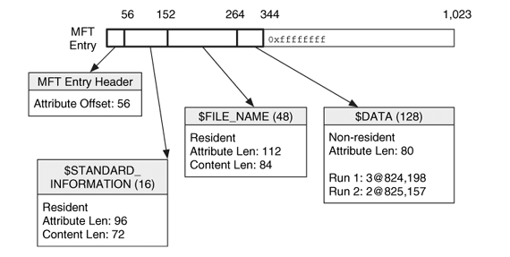
Metadata Category Analysis (cont’d)
The MFT entry for a basic file with the attributes lengths given to show how an entry is processed
Notes:
Typically, we look at the attribute header to figure out the offset to the first attribute or the starting point of the first attribute. Then, we can iterate all the attributes in a MFT entry.
Based on these attributes’ Attribute type identifiers, we are able to locate these attributes containing the metadata information, including $STANDARD_INFORMATION, $FILE_NAME and $DATA attributes.

Slide 82

Signature (“file”)
Offset to first attribute = 56
first attribute = Type: 16, length: 96
second attribute = Type: 48, length: 104
third attribute = Type: 128, length: 72
Notes:
This is an example showing how we can locate these attributes containing the metadata information, including $STANDARD_INFORMATION, $FILE_NAME and $DATA attributes.
Note that a MFT entry always start with “FILE” unless it is marked damaged or bad (then it would start with “BAAD”).
So we first take a look at the field at byte offset 20, knowing the offset to the first attribute or the starting point of the first attribute.
The value in the field at byte offset 20 is 0038 in hex, which is converted to 56 in decimal.
So we know the first attribute starts at byte offset 56. Then, we check its first two 4-byte fields, which are its Attribute type identifier and its length. As such, we can know whether or not it is the attribute containing metadata information.
By design, the attributes immediately follow one after the other. So, we can iterate all the attributes in a MFT entry.
Therefore, we are able to locate these attributes containing the metadata information, including $STANDARD_INFORMATION, $FILE_NAME and $DATA attributes.

Slide 83

Filename Category
Issue: linking a file name with its contents
Notes:
Next, we look at how to analyze file name data in NTFS. Basically, we look at one particular attribute, $FILE_NAME attribute, which we already given a detailed analysis in the begin of the lecture.

Slide 84
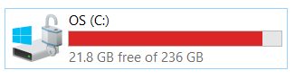
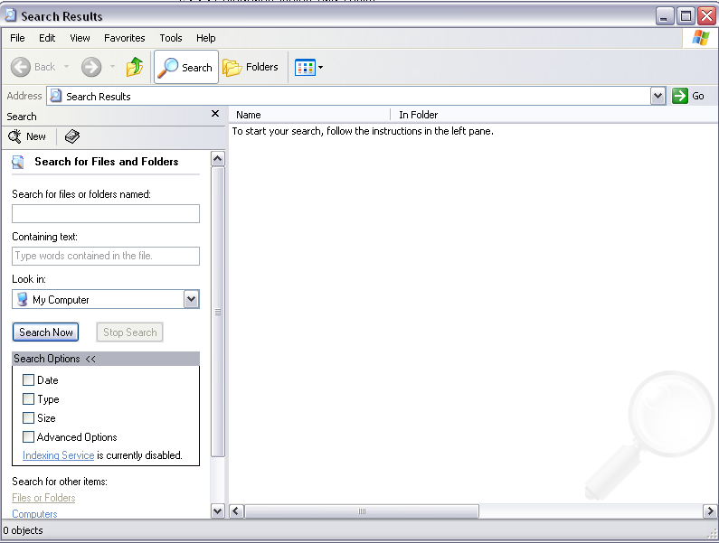
Filename Lookup
C:\Windows\Tasks\ABC.TXT
Notes:
As you know, many OSes provide file search function based on file name. In the example here, you search for a file named abc.txt in the folder \Windows\Tasks in c drive.

Slide 85
Filename Lookup (cont’d)
The operating system starts a search for a filename starting from the root directory in NTFS volume labelled C:
Directory
\Devices
MFT for Volume 1
C:
D:
Disk Volume 1
filename
MFT Entry 5
Root Dir
Step 1: Look up C:
Step 2: Go to disk partition
Step 3: Look up pathname
Step 4: Do work with filename
Notes:
What happened?
The operating system starts a search for a filename at the root directory in NTFS volume labelled C:, which is a partition of a disk formatted with a NTFS file system.
So the OS first goes to the disk partition where C drive resides. It is done by volume analysis.
Then, the OS locates the MFT file, particularly, inspecting MFT Entry 5, which is the root directory in NTFS.
Afterwards, iterate through directories based on the given file path, and locate the MFT entry representing the file abc.txt if found.

Slide 86


File Creation Example
Notes:
Finally, let’s use an example to put together everything we have learned up until now.

Slide 87
File Creation Example (cont’d)
Create the file \dir1\file1.dat where filesize = 4,000 bytes
Read the 1st sector and process boot sector to determine cluster size, starting address of MFT and size of each MFT entry. Assume clustersize = 2, 048 bytes
Read 1st entry of MFT which is $MFT file and determine layout of MFT
Allocate an MFT entry for the new file by using its $BITMAP attribute to find an unused entry, say 304, and set corresponding bit to 1
Create $STANDARD_INFORMATION and $FILE_NAME and set times to current time
Allocate 2 clusters for the file by using $DATA attribute of $BITMAP file, MFT entry 6.
Suppose clusters 692 and 693 are found using best-fit algorithm and write file content. Also, their allocation status are updated accordingly.
Notes:
Suppose we want to create the file \dir1\file1.dat where the file size is 4,000 bytes.
So we first analyze the partition boot sector to figure out cluster size, starting address of MFT and size of each MFT entry. Assume that the cluster size is 4 sectors or 2, 048 bytes.
Then, read 1st entry of MFT which is $MFT file itself, and determine the location of MFT.
Afterwards, allocate an MFT entry for the new file by using its $BITMAP attribute to find an unused entry, say 304, and set corresponding bit to 1. The $MFT file contains a $BITMAP attribute that indicates which MFT entries are in use.
Based on the file size and the cluster size, we know the new file needs two clusters. So, allocate 2 clusters for the file by using $DATA attribute of $BITMAP file, MFT entry 6. Suppose that clusters 692 and 693 are found using best-fit algorithm and write file content. Also, their allocation status are updated accordingly. Note that the $BITMAP file contains a $DATA attribute that indicates which clusters are in use.
At the same time, Mac times are updated as well, particularly, in both $STANDARD_INFORMATION and $FILE_NAME attributes. It is worth noting that How these timestamps change depending on the Windows operating system you use.

Slide 88
File Creation Example (cont’d)
Create the file \dir1\file1.dat where filesize = 4,000 bytes and clustersize = 2, 048 bytes
The root directory, in MFT entry 5, is processed to locate dir1. Read the $INDEX_ROOT and $INDEX_ALLOCATION and traverse sorted tree to find the dir1 index entry, which is assumed its MFT entry is 200.
Seek to MFT entry 200 and find the location where file1.dat should go. Then, a new index entry is created for it, and the tree is resorted. Assume the new index entry has the MFT entry 304 in its file reference address.
Entries made for file system journal (logging) and new file size modified if quotas
Notes:
Then, we need to put the file into its correct location, which is the folder \dir1 where the new file is located.
So we will first find the root directory in the NTFS volume, which is MFT entry 5. Note that the file names in NTFS are indexed. Then, we search the sorted tree to find the dir1 index entry, which is assumed its MFT entry is 200.
Afterwards, seek to MFT entry 200 and find the location where file1.dat should go. Then, a new index entry is created for it, and the index tree is resorted. Assume the new index entry has the MFT entry 304 in its file reference address.
NTFS file system is a Journaling File System. Therefore, the changes on the NTFS volume are logged.

Slide 89
File Creation Example (cont’d)
Boot Sector
MFT Entry Bitmap
...1...
\Index
0
$MFT
$LogFile Journal
mirror
2
$logFile
...
dir1 200
...
Cluster Bitmap
5
RootDir
...11...
6
$Bitmap
File1.dat $DATA attribute
dir1 Index
...
File1.dat 304
200
dir1
...
Cluster 692
Cluster 693
304
File1.dat
Final state after adding the “\dir1\file1.dat”
Notes:
Next, I will use a simple diagram to visually show the file creation in NTFS.
Specifically,
1. Allocate an MFT entry for the new file by using its $BITMAP attribute to find an unused entry, say 304, and set corresponding bit to 1.
2. Allocate 2 clusters for the file. Suppose that clusters 692 and 693 are found. Also, their allocation status are updated accordingly in the $BITMAP file.
3. Since the file names in NTFS are indexed, a new index entry is created for the new file, and is inserted into the index tree for the folder dir1
4. NTFS file system is a Journaling File System. Therefore, the changes on the NTFS volume are logged, particularly, saved into the $LogFile file, a File System Metadata File in NTFS, which is associated with MFT entry 2.

Slide 90
File Deletion Example
Boot Sector
MFT Entry Bitmap
...0...
\Index
0
$MFT
$LogFile Journal
mirror
2
$logFile
...
dir1 200
...
Cluster Bitmap
5
RootDir
...00...
6
$Bitmap
File1.dat $DATA attribute
dir1 Index
...
200
dir1
...
Cluster 692
Cluster 693
304
File1.dat
Final state after deleting the “\dir1\file1.dat”
Notes:
What if we then delete the newly created file?
Then, the MFT entry 304 and clusters 692 and 693 become unallocated.
[click]
Also, the index entry for the new file is removed as well, and the index tree for the folder dir1 is resorted when necessary.
However, the file contents still remain in these two clusters.

Slide 91

Discussion
How possible is it to recover deleted files in NTFS?
Notes:
How possible is it to recover deleted files in NTFS? Of course, it is possible as far as the deleted file’s content is not overwritten.
But, it could be challenging to recover a deleted file in NTFS since some complex data structure is used in NTFS.

Slide 92


Discussion (cont’d)
Automating a process that is currently done manually (we discussed so far) to recover a deleted file in FAT and NTFS!
We solve it in a Computer Science way!
Notes:
We have built up lots of experience in manually recovering deleted files in different file systems such as FAT and NTFS. We also need to automate the process that is currently done manually to recover a deleted file in FAT and NTFS! This is part of our job as a digital forensic researcher.

Slide 93
File Recovery
When a file is deleted:
The name is removed from the parent directory index
The MFT entry is unallocated
Clusters are unallocated, but the file contents still remain in these clusters.
Problem: when filename is removed from parent directory, the index is resorted and name information could be lost
However, MFT entries are found in the MFT, so all unallocated entries can be found
The deleted files' data that has not been overwritten can be recovered.
Notes:
Similar to other file systems such as FAT file system, when a file is deleted, the MFT entry associated with the file is unallocated. Clusters are unallocated, but the file contents still remain in these clusters.
Also, the file name is removed from the parent directory index.
However, there is a challenge facing deleted file recovery in NTFS. When the file name is removed from parent directory, the index is resorted and file name information could be lost. As such, you may not find the file name about a deleted file.
However, MFT entries are found in the MFT, so all unallocated entries can be found
As far as the deleted files' data has not been overwritten, they can be recovered.

Slide 94


Data Unit Viewing Technique
ifind
istat
blkcat
Notes:
Next, I will use some real examples to discuss some popular analysis techniques for NTFS.
We first look at Data Unit Viewing Technique. In this case, we may know the cluster address, and then we would like to view the content contained within the cluster.

Slide 95
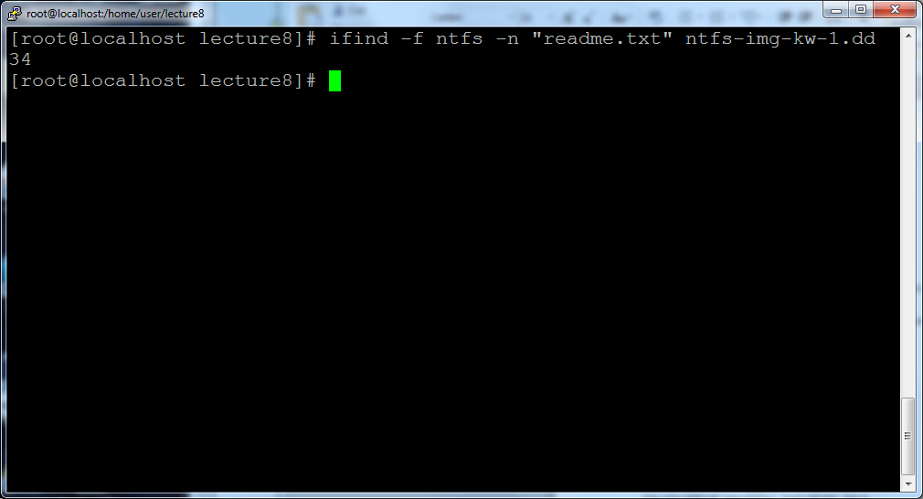
MFT Entry 34 = readme.txt
Notes:
Suppose we are interested in knowing the details of a file named readme.txt in a NTFS volume. So we can use the TSK utility ifind to find the meta-data structure (a MFT entry number in NTFS) that has a given file name, readme.txt.
The output shows MFT entry 34 is allocated to the file readme.txt.

Slide 96
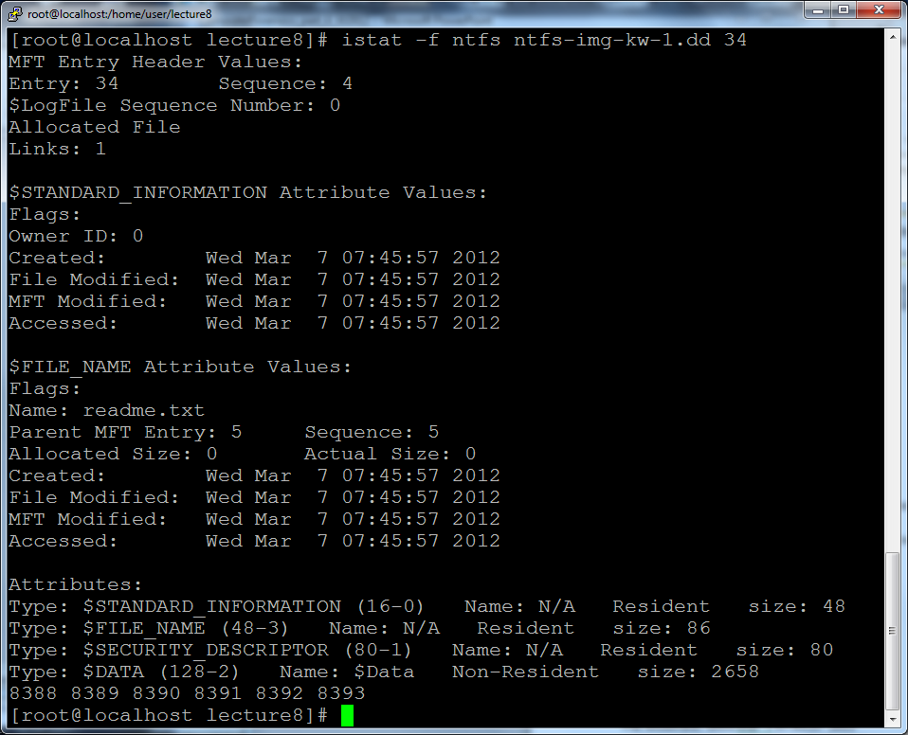
1st cluster=
8388
Notes:
Then, we can use the TSK utility istat to display the details about a given meta data structure, which is MFT entry 34.
Remember metadata contains the location of data units allocated to a file as well as some important timestamps.
Next, we will take a look at the location of data units, which are contained in the $DATA attribute.
Note that the $DATA attribute in the example of the MFT entry 34 is a non-resident attribute. It means that the file content is stored outside the MFT entry 34, and instead, is saved in some data units or clusters.
For example, the readme.txt occupies 6 clusters, and the first cluster is Cluster 8388.

Slide 97
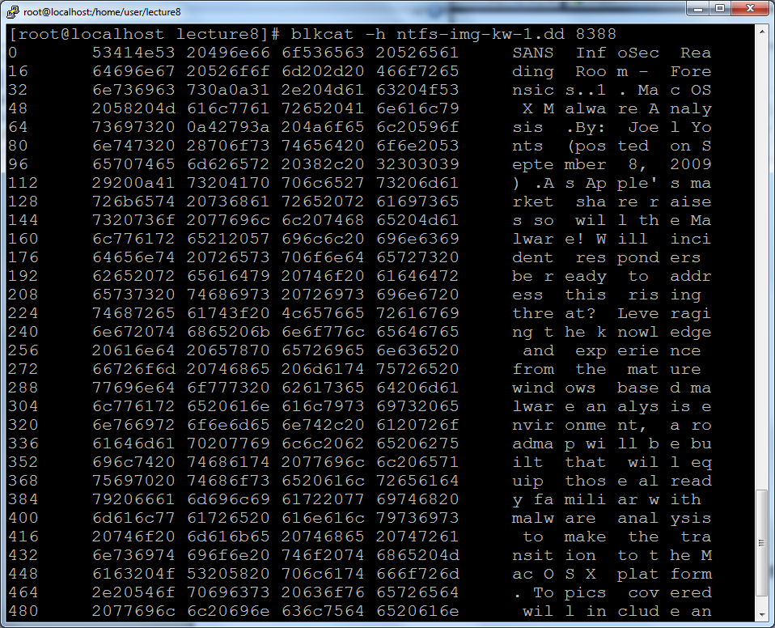
1st cluster of Readme.txt
Notes:
Finally, we use the TSK utility blkcat to display the content in Cluster 8388, which is the first cluster allocated to readme.txt.

Slide 98
Data Unit Allocation Status
istat
blkcat
Notes:
We next look at Data Unit Allocation Status analysis Technique for NTFS. In this case, we would like to know the allocation status for some data unit or cluster.

Slide 99

MFT Entry - cluster allocation
Entry | File Name | Description
6 | $Bitmap | Contains the allocation status of each cluster in the file system.
The $Bitmap file contains an unnamed $DATA attribute that indicates which clusters are in use, $BITMAP’s $DATA attribute that has one bit for every cluster in the file system
If the bit = 1 the cluster is allocated, if the bit=0 it is unallocated
Cluster 1
Cluster 0
Bit 7
Bit 0
Byte 0
00101101
Clusters 0-7
Byte 1
11111111
Clusters 8-15
Notes:
Recap that in NTFS, there is $BITMAP, which is a File System Metadata File in NTFS. It is associated with MFT entry 6.
It's $DATA attribute has one bit for every cluster in the file system, which indicates allocation status.
If the bit = 1 the cluster is allocated, if the bit=0 it is unallocated.
The first byte of the $BITMAP file indicates allocation status of the first 8 clusters in a NTFS volume.
In the example here, the first byte of the $BITMAP file is 00101101. It means Cluster 0 is allocated, but Cluster 1 is unallocated.

Slide 100
Cluster Allocation
$Bitmap DATA
Bit 7
Bit 0
Readme.txt
1st Cluster 8388
Byte 0
……..
Byte 1
……..
……
Floor(8388/8)
=1048
=0x418
Byte ?
xxxxxxx
Notes:
Next, we take a look at allocation status of these clusters occupied by the readme.txt file. From the first case study, we know the readme.txt occupies 6 clusters, and the first cluster is Cluster 8388.
So we can calculate the byte location in the $BITMAP file, showing the allocation status of these clusters occupied by the readme.txt file. For example, we want to know the allocation status of Cluster 8388.
[click]
Specially, we divide the cluster address 8388 by 8, and then apply floor function. We obtain the byte location for the allocation status of Cluster 8388. We obtain byte offset 1048

Slide 101
Cluster Allocation (cont’d)
Readme.txt
Clusters 8388 8389 8390 8391
8392 8393
Byte 1048=0x418
xxxx…..
Byte 1049=0x419
……xx
Notes:
Note that the readme.txt occupies Clusters 8388 to 8393.
Then, we take a look at the value at byte offset 1048 in the $BITMAP file. The top 4 bits show the allocation status of Clusters 8388 to 8391.
Also, we know the lower 2 bits of the value at byte offset 1049 show the allocation status of Clusters 8392 to 8393.

Slide 102
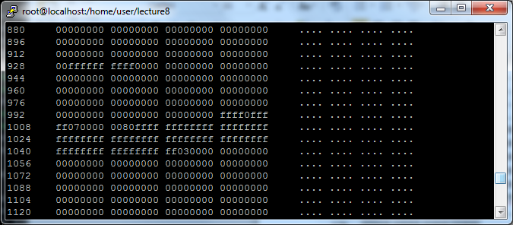
Cluster Allocation (cont’d)
Byte 1048=0x418
Clusters 8384-8391
Byte 1049=0x419
Clusters 8392-8399
Clusters 8388 8389 8390 8391 8392 8393
Notes:
Finally, we validate our analysis results. Note that since the readme.txt occupies Clusters 8388 to 8393, therefore their allocate status must be all 1.
The example here show the hex dump of the $BITMAP file. It can be observed that the top 4 bits of the value at byte offset 1048 and the lower 2 bits of the value at byte offset 1049 are all 1, which means they all are allocated.

Slide 103


Evolution of NTFS
V. 1.0
V. 3.0
(aka NTFS 5.0)
V. 1.2
(aka NTFS 4.0)
V. 3.1
(aka NTFS 5.1)
V. 1.1
Windows NT 3.1
NT 3.5
NT 4
Windows 2000
XP
1993
1994
2000
2001
Present
1996
No published specification from Microsoft!
Notes:
NTFS supersedes the file allocation table (FAT) file system as the preferred file system for Microsoft Windows operating systems.
NTFS is a very complicated filesystem, and has gone through an evolution of several major versions, starting from v.1.0, first introduced in mid-1993 to today's widely version, v.3.X in year 2000.
While the main system structure of the NTFS file system has not changed, many new features have been introduced over the years.
Both academia and industry have put lots of efforts to study how NTFS works, there Is still a long way to go in order to completely understand NTFS and its forensic implications.

Slide 104

Reading materials
Chapters 7, 8
Forensics Analysis Approach To NTFS File System
https://www.xploreforensics.com/blog/ntfs-file-system-forensic-analysis.html
Analysis of hidden data in the NTFS file system
https://citeseerx.ist.psu.edu/viewdoc/download?doi=10.1.1.114.8953&rep=rep1&type=pdf
Windows 7 MFT Entry Timestamp Properties
https://www.sans.org/blog/windows-7-mft-entry-timestamp-properties/

